Slide 1

Early cardio disease prediction using machine learning

Slide 2



Introduction
Welcome to the revolution of
through advanced prediction models using
.
will explore the of
and
This presentation potential impact
cutting-edge
technology on predicting and preventing cardiovascular diseases.

Slide 3
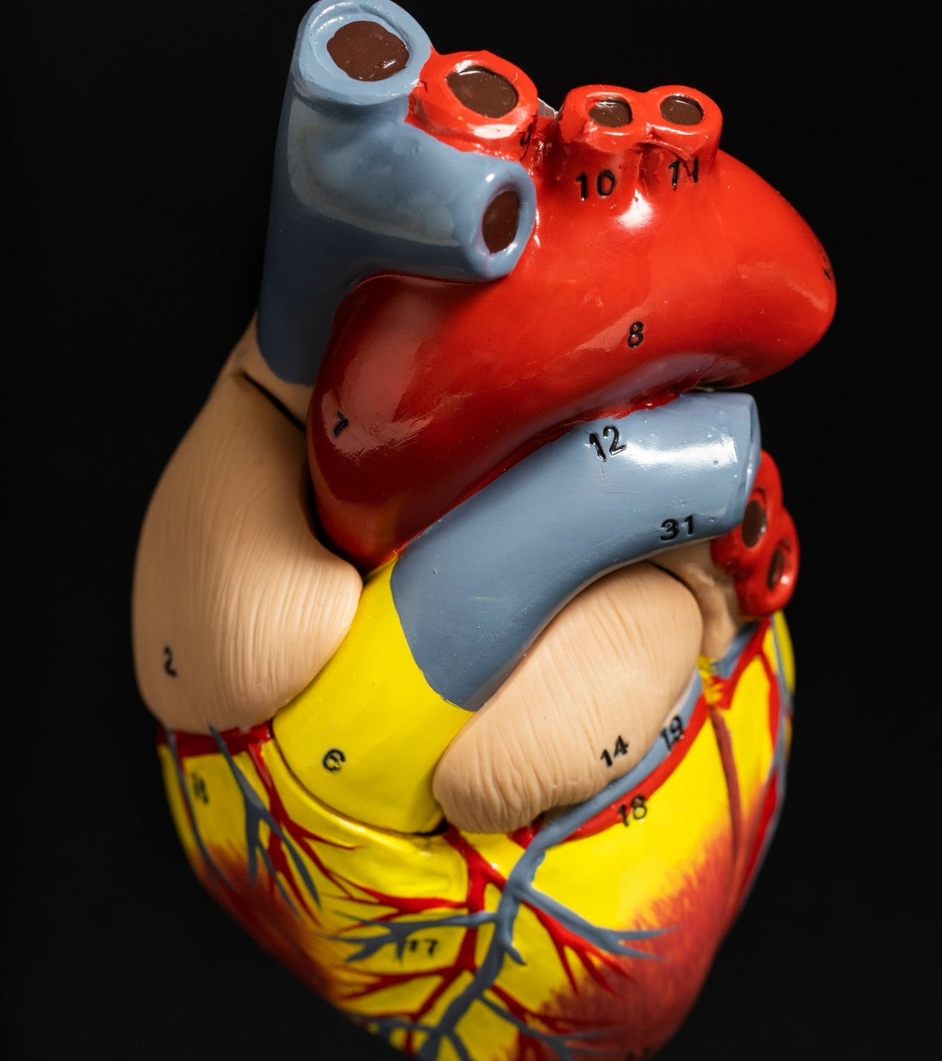



Cardiovascular Diseases
Understanding the and of cardiovascular diseases is
crucial.
With the advancements in predictive modeling.
We can burden improve
potentially of these
reduce the diseases and
.

Slide 4
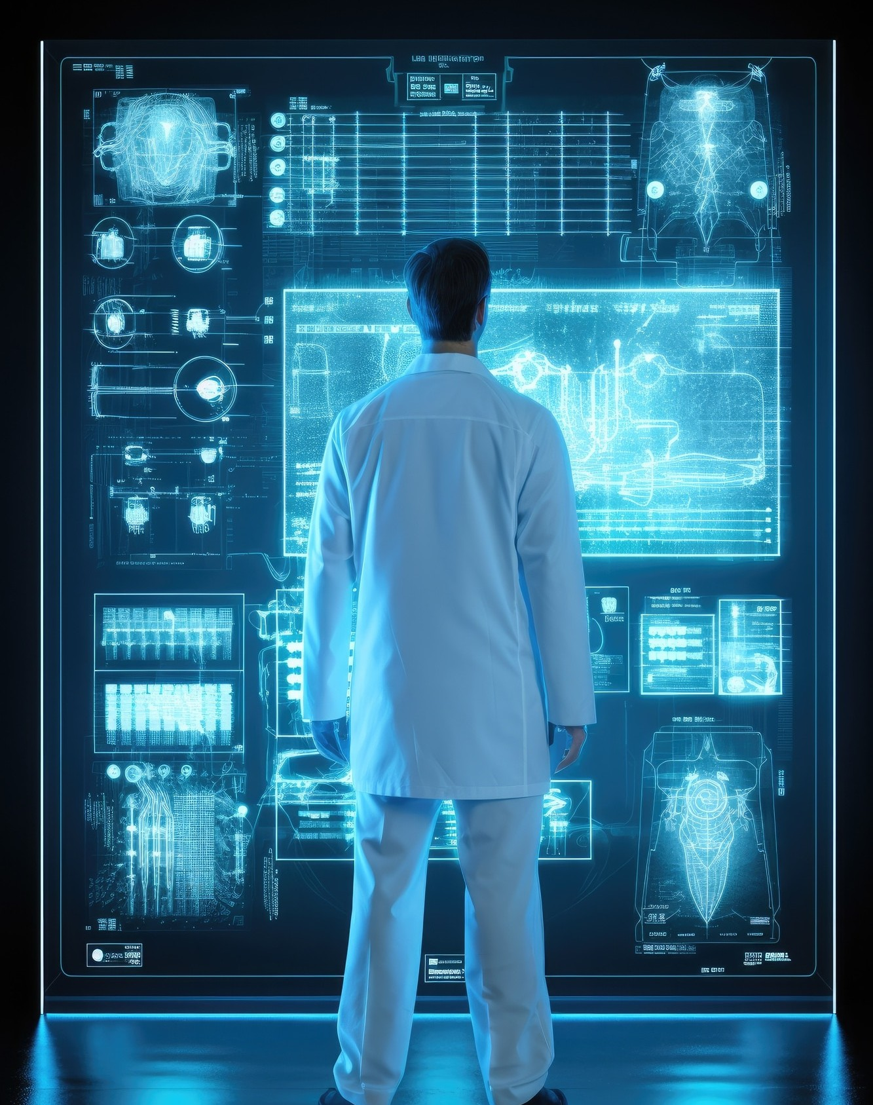



Machine Learning in Healthcare
Explore the role of in healthcare and its potential to revolutionize cardiovascular health.
From to
, machine learning offers promising solutions.

Slide 5
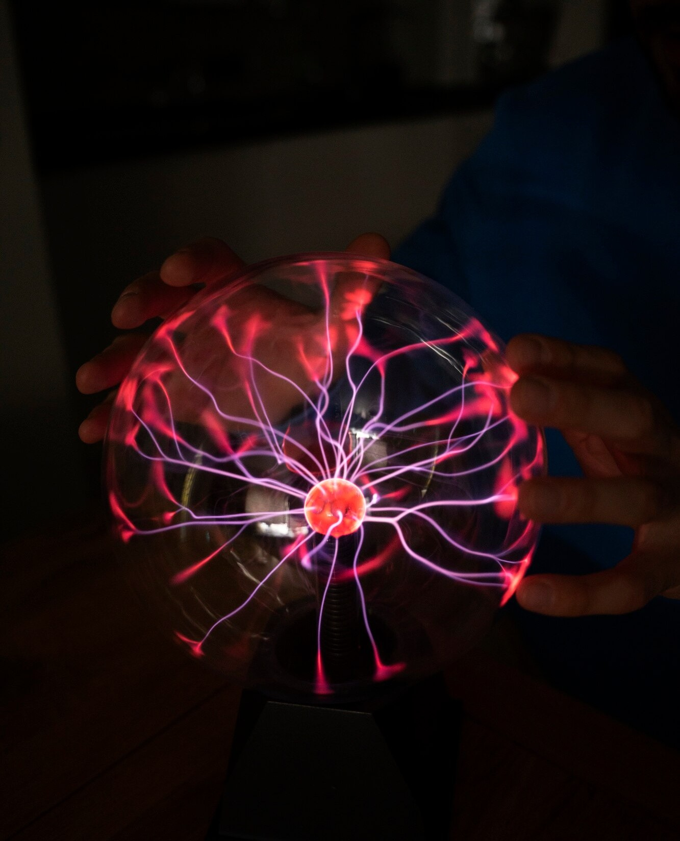




Deep Learning Applications
Discover
the potential of predicting cardiovascular
events .
The ability to analyze complex data sets and identify subtle patterns holds great promise for the future of cardiovascular care.

Slide 6







Challenges and Opportunities
Identify the
and
in leveraging
predictive models for cardiovascular-health.
Addressing issues such as
and while
embracing personalized crucial.
the potential for interventions is

Slide 7
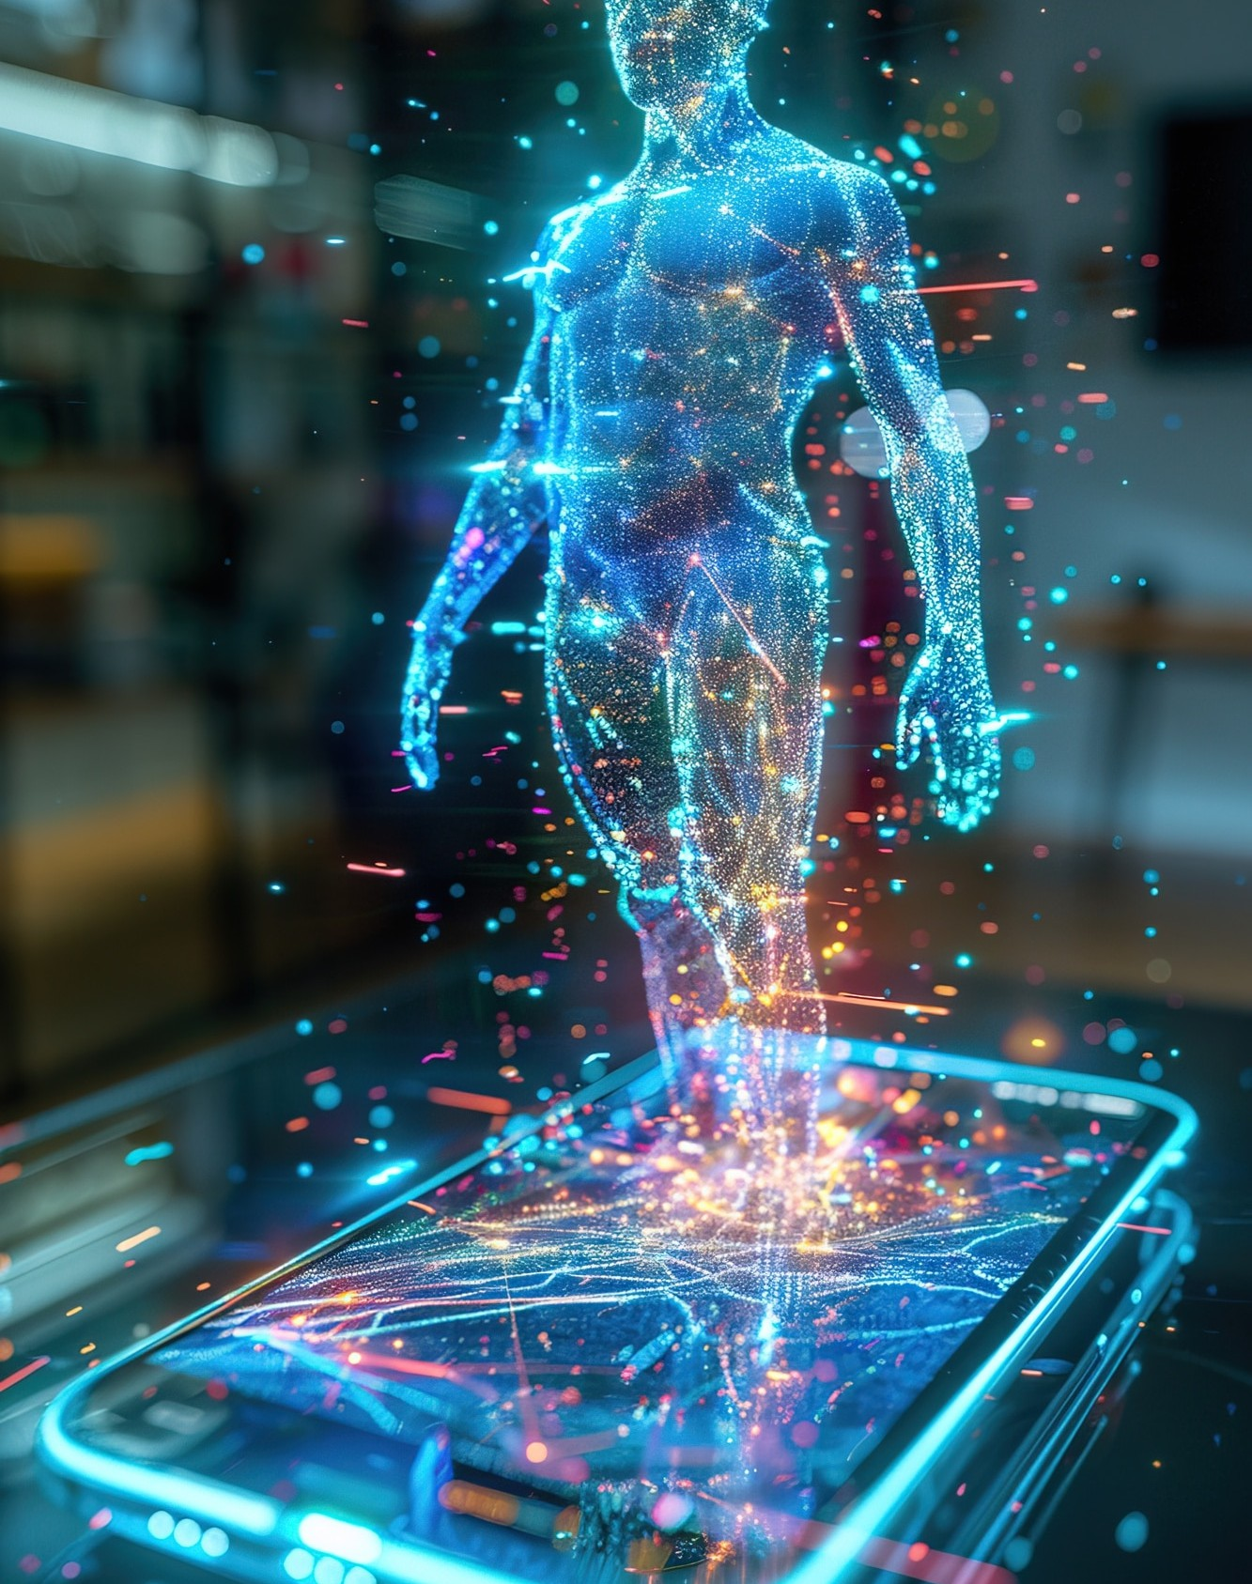


Future Perspectives
Envision the future of cardiovascular health with advanced prediction models.
From
to
, the potential for transforming
cardiovascular care is boundless.

Slide 8

Implementation Strategies
Data Collection and Preprocessing.
Test and train the ML models.
Creating frontend web page.
Deployment of web app using ﬂask .
Extracting the output.

Slide 9
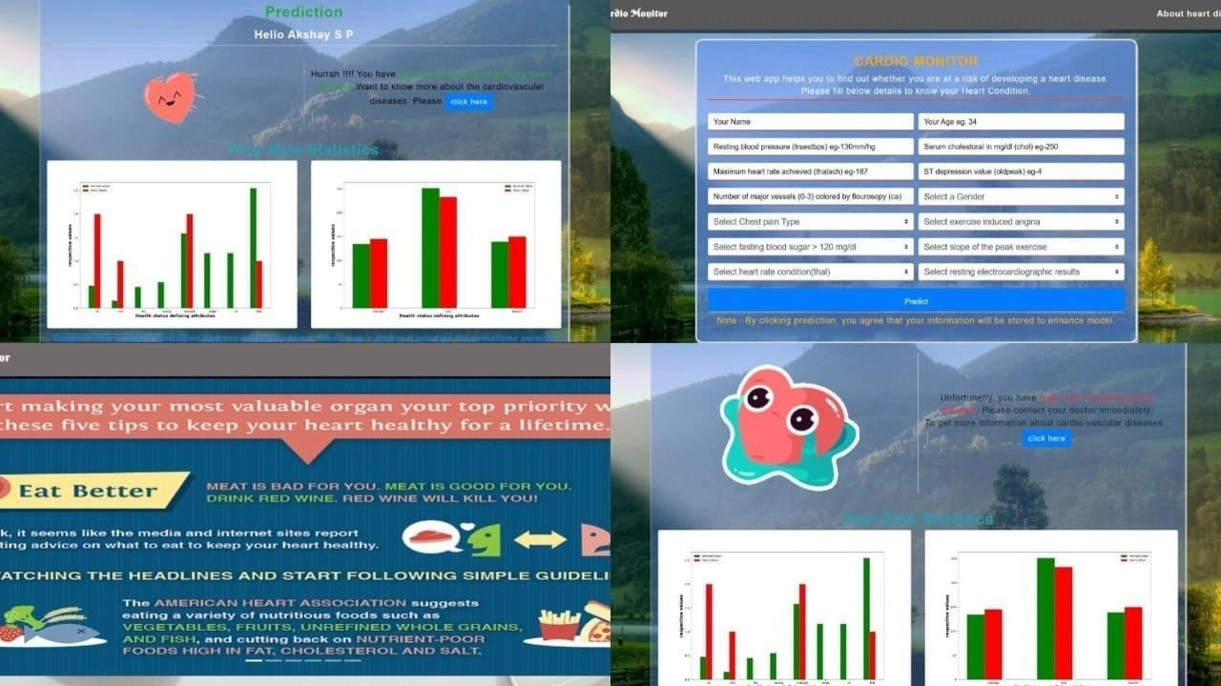

Slide 10
Conclusion
In conclusion, the integration of machine learning and deep learning in predictive modeling has the potential to revolutionize cardiovascular health. Embracing the opportunities while addressing the challenges is essential for realizing the full impact of these advancements.

Slide 11
Thank You!

